Slide 1

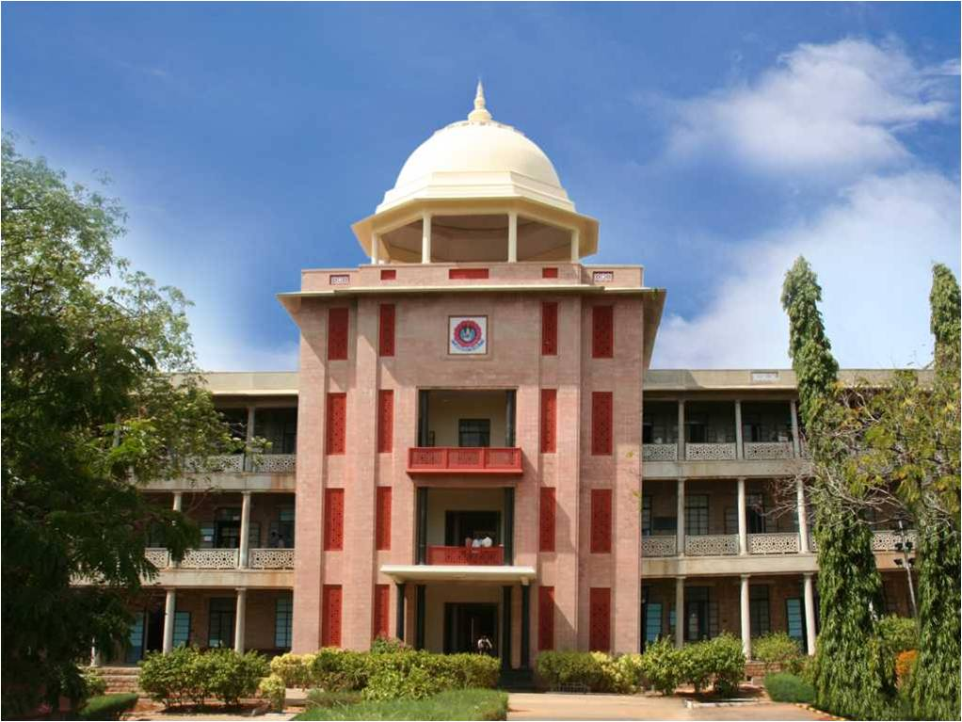
IOT BASED PRODUCT RECOMMENDATION SYSTEM USING MACHINE LEARNING
THIAGARAJAR COLLEGE OF ENGINEERING, MADURAI-15
(A Govt. Aided Autonomous Institution affiliated to Anna University)
- where quality and ethics matter
GUIDE :
Dr C Sridharan
TEAM MEMBERS :
Naveen Karthik K 19C059
Nitin Vinayak S 19C062
Rajarajesvarri G 19C077
10/02/2023
<Department Name>

Slide 2
Introduction
In today's world, one of the major problems faced by Shop-Owners is the lack of data and insights on customer preferences and behavior.
This makes it difficult for the shopkeepers to make decisions regarding the restocking of items in their shop.
Here comes the Inventory Management System into play, where we use a smart trolley to detect items that the customers put in their trolley during shopping. It uses RFID and collects required data while it also carries out automated billing.
We then feed the data collected from the customer's shopping behaviors to a Machine Learning model and give a personalized recommendation to the shopkeeper about the items that they might want to restock.
10/02/2023
Department of Computer Science and Engineering

Slide 3
Literature Review
Automated Shopping Cart Using RFID
Recent advancements in technology have seen a significant reduction in human intervention. New technologies are introduced to replace outdated conventions where emphasis is put on the incorporation of Artificial Intelligence and Automation in our daily lives. One of the most important sectors affected, the shopping industry, needs to adapt to meet government and social security standards. This paper addresses a Smart Shopping Cart System where the entire shopping experience is automated and handled by the customer. It details a more efficient online mode of shopping which not only reduces the need for hands-on staff but also provides specialized recommendations to users using collaborative clustering to update the shopping experience and meet the demands of our time. The current shopping system has many limitations, and introduction of Radio-Frequency Identification (RFID) technology as the core identification mechanism can prove useful for applications such as security, safety and inventory management.
10/02/2023
Department of Computer Science and Engineering

Slide 4
Literature Review
Smart Trolley for Smart Shopping with an Advance
According to this paper, in the current scenario, people are more attracted to buy groceries from Supermarket/Hypermarket. In such a case, finding the essential need of any customer in supermarket consumes more time and after all findings the customer need to wait in the billing queue to complete billing process of the selected product. Currently, due to the Covid-19 pandemic, the customers are strictly instructed to maintain social distance but practically it is not possible especially in the billing process. To overcome this significant challenge, this research work proposes a smart trolley based on Internet of Things [IoT] with an advanced billing system that makes shopping easier and secured and also avoids standing in long queue. The proposed system consists of a smart trolley attached with LCD display, barcode scanner and a Raspberry-pi. This exploratory model is intended to completely eradicate the tedious shopping interaction and administration-related issues. The proposed framework can be undoubtedly implemented at a business scale under the genuine situation.
10/02/2023
Department of Computer Science and Engineering

Slide 5
Literature Review
Product Recommendation System for Supermarket
Customers who seek the services at supermarkets are subjected to inconsistencies & ambiguities over choosing their desired products from a wide range of products with the closest quality. Meanwhile, supermarkets find it very difficult to satiate the customers’ demand. Therefore, proposing a method to analyze the customers’ need plays an important role in attracting new and regular customers. The purpose of this study is to formulate a product recommendation system which analyze customers’ needs and thus recommend the best products. This system recommends products to the regular customers and to the new customers as well. New customers mean obviously the customers with no purchasing history at the supermarket in question. The system referred to recommends the products to the new customers using up two method. One method recommends the most popular products while the other method solely focuses on the product description for recommendation.
10/02/2023
Department of Computer Science and Engineering

Slide 6
Literature Review
Product Recommendation System for Supermarket
(continuation)
The system recommends the products to the regular customers using up user-based collaborative filtering, item based collaborative filtering and association rule mining. It recommends products to regular customers based on purchasing history and priority ratings given by other users who bought the products. Initially, the recommendation algorithm finds a set of customers who purchased and rated the products that overlap with the user who purchased and rated the products. The algorithm aggregates products from the customers with similar preference and eliminates the products the user has already purchased or rated. The proposed methodology improves the shopping experience of customers by recommending accurately and efficiently the products that are personalized to the need of the customers.
10/02/2023
Department of Computer Science and Engineering

Slide 7
Problem Formulation
The problem faced by the offline store owners is the lack of data and insights on customer preferences and behavior. This can make it difficult for them to make informed decisions on inventory, promotions, and marketing strategies and to recommend products based on the availability of the current stocks and arrival of new stocks.
An IoT-based recommendation system using machine learning could help store owners collect and analyze data on customer interactions and preferences, and provide personalized recommendations for products and promotions to the store owners and make the most sold and it’s related products always available. This would help store owners increase sales and improve customer satisfaction.
10/02/2023
Department of Computer Science and Engineering

Slide 8
Objectives
To automate the billing process instead of waiting for long queues at stores.
To recommend a particular product and all of it’s related products based on the availability of current stocks and arrival of new stocks.
To manage the stocks better by collecting the necessary information such as the goods sold, available goods and to recommend the frequently sold products and their related products.
To implement better marketing strategies, to increase the sales of goods and services and make the business profitable.
10/02/2023
Department of Computer Science and Engineering

Slide 9
Methodologies to meet the Objectives
To automate the billing process, we use a RFID scanner and read the objects that the customer places in their trolley during shopping.
We have chosen the RFID scanner because it the one of the most recent technologies that has proven to be very efficient. RFID is the optimal scanner that we can use to automate the billing process in shops.
We use a Arduino to build the RFID scanner system. And we use Wokwi as the simulation tool in case of IoT.
In Inventory Management aspect, we use machine learning to build a recommendation system to recommend the shopkeepers with the products that they might want to restock.
10/02/2023
Department of Computer Science and Engineering

Slide 10
Work Completed
10/02/2023
Department of Computer Science and Engineering

Slide 11
Expected Outcomes
For the Smart trolley to read the RFID cards in the items and automatically add it to the customer's bill. At the end all the customer has to do is pay and take delivery of the items.
The shopkeepers will be provided with a clear recommendation of the products they need restock.
The shop-owners can manage the stocks better by collecting the necessary information such as the goods sold, available goods and to recommend the frequently sold products and their related products.
10/02/2023
Department of Computer Science and Engineering

Slide 12
Action Plan
Construct an IoT-based Scanner system that uses RFID scanner to scan the items.
Fit the Scanner system into a shopping trolley in-order to achieve automated billing.
Build a Recommendation system using machine learning.
Code to feed the data collected using the scanner into the Recommendation system.
Code to display the recommended products outputted by the model.
10/02/2023
Department of Computer Science and Engineering

Slide 13
References
10/02/2023
Department of Computer Science and Engineering

